Slide 1
Applying Design Patterns to Solve Everyday Problems
Iowa Code Camp
July 23, 2016
David Berry

Slide 2

About Me
Solution Architect for Robert W Baird in Milwaukee
Pluralsight Author
Occasional social media contributor
Twitter - @DavidCBerry13
Blog – http://buildingbettersoftware.blogspot.com
Code on Github
https://github.com/DavidCBerry13/DesignPatternsTalk-IowaCodeCamp/

Slide 3
What is a Design Pattern?
Wikipedia - https://en.wikipedia.org/wiki/Software_design_pattern
In software engineering, a software design pattern is a general reusable solution to a commonly occurring problem within a given context in software design. It is not a finished design that can be transformed directly into source or machine code. It is a description or template for how to solve a problem that can be used in many different situations. Design patterns are formalized best practices that the programmer can use to solve common problems when designing an application or system.

Slide 4
What is a Design Pattern? Really?
Formalized, reusable solution to a common problem
An elegant solution with a well thought out design
Well understood by the software development community

Slide 5
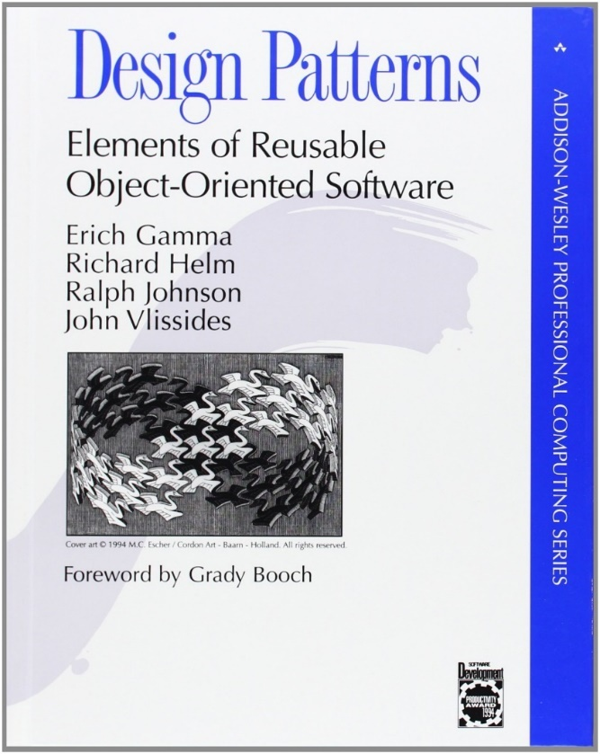
How Do I Learn About These Things?
Books describe how to implement the different patterns, but it is often times difficult to know when to apply them

Slide 6
Isolation From Dependencies
Our Code
Interface
Dependency

Slide 7

Bridge Pattern
Uses an interface to isolate your code from different implementations
Allows you to easily switch out implementations behind the bridge
Allows code to be tested without the dependency
Useful whenever you have external dependencies

Slide 8
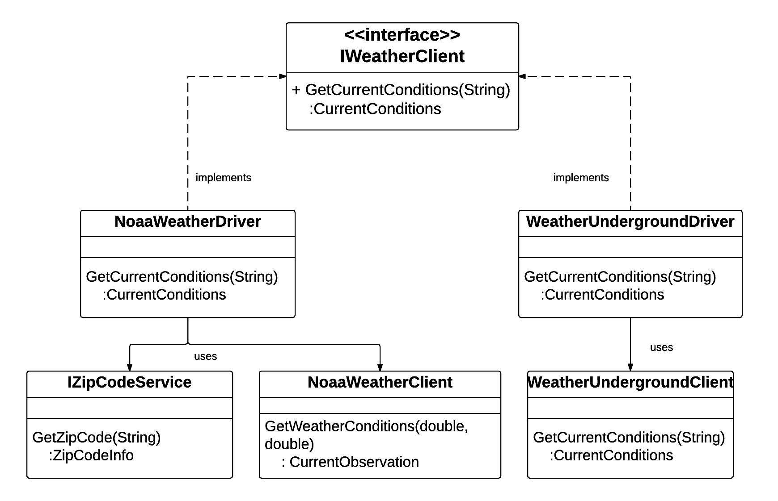
Bridge Pattern

Slide 9
Decorator
Decorator
Effectively wraps one object inside of another
Decorator objects implement the same interface as the object they are decorating
Objects can be decorated multiple times
Useful for cross cutting concerns
Decorator
Object

Slide 10
Chain of Responsibility
Payment Data
Think of a series of multiple handlers that can each handle a request
Each handler is focused on a single use case
If a handler cannot process the request, it passes the request to the next handler in the chain
Order can be important (depending on your use case)
CreditCardPaymentTypeHandler
EftPaymentTypeHandler
Falls through until handled
CheckPaymentTypeHandler

Slide 11
Resources
Head First Design Patterns (Book)
http://shop.oreilly.com/product/9780596007126.do
Design Patterns On-Ramp (Pluralsight Course)
https://www.pluralsight.com/courses/design-patterns-on-ramp
C# Interfaces (Pluralsight Course)
https://www.pluralsight.com/courses/csharp-interfaces
Design Patterns Library (Pluralsight Course)
https://www.pluralsight.com/courses/patterns-library

